Slide 1
Local Journalism under Private Equity Ownership
Michael Ewens (Columbia, NBER)
Arpit Gupta (NYU Stern)
Sabrina Howell (NYU Stern, NBER)
May 2022

Slide 2
Our Authors
WSU
Michael Ewens
Ewens focuses almost entirely on venture capital and private equity, most recently at Columbia Business School.
Arpit Gupta & Sabrina T. Howell
Gupta works primarily with large datasets pertaining to household finance, default, and real estate while Howell focuses on entrepreneurship, PE, and fintech

Slide 3
Why PE? Newspapers are Different
WSU
De Tocqueville (1835) wrote that the United States
“makes use of an unlimited freedom of political association… Newspapers make associations, and associations make newspapers… Thus, of all countries on earth, it is in America that one finds both the most associations and the most newspapers.”
Local, daily newspapers key source of local gov’t news and investigative journalism
Media and news environment is changing in the sample period (2000-2019)
Craigslist is cannibalizing classified ads (revenue sources/competition)
Internet for information acquisition (news delivery)
“news” from social networks (competition)

Slide 4
Just a Local Issue?
WSU
“Following De Tocqueville, a large body of literature argues that local newspapers are crucial to modern representative democracy, because they hold local leaders accountable and increase civic engagement (Snyder and Strömberg, 2010).”
Readership of local newspapers has declined drastically alongside revenue
Voters’ knowledge of local policy issues has declined
A trend of increased nationalization of U.S. politics (straight-ticket/party-line) voting has emerged (Hopkins, 2018)

Slide 5
Does PE Ownership Spell Death, or A Second Chance?
WSU

Slide 6
Does PE Ownership Spell Death, or A Second Chance?
WSU
“Michael Bush led the creation of Civitas Media through the consolidation of Heartland Publications, Ohio Community Media, Impressions Media and certain newspapers from Freedom Central. Under his leadership, the company achieved significant cost synergies by successfully streamlining operations. It also launched new on-line and mobile platforms and introduced a number of creative revenue initiatives.”

Slide 7
PE Ownership – Costs or Improvement?
WSU
Evisceration of Local News vs. Investments in Digital Platforms
“In this view, investment in information technology need not compromise the quality of local news reporting.”
Operational Outcomes Considered
Private equity buyouts are associated with print circulation declines, but large increases in digital circulation.
Private equity-owned newspapers invest in digital technologies, which increase digital access to newspaper content.
Private equity owners do not quickly shut down firms after extracting rents.
Private equity ownership is associated with a raise in digital circulation partially at the expense of print circulation while also improving survival prospects.

Slide 8
PE Ownership – Costs or Improvement?
WSU
Research Question: How does PE ownership impact newspaper operations, local news coverage, and community outcomes?
Comprehensive daily newspaper data: textual content, circulation, ownership (including PE deals), employment, political outcomes 2001-2019
Empirical Strategy: Diff-in-diff around PE ownership (5% → 23% over sample)
Findings:
Digital circulation $↑$ 43%
Newspaper survival $↑$
Employment $↓$ 6.9%, especially reporters and editors
Local news content $↓$ 10.8%, while national news increases
Local political awareness and turnout $↓$
Nuanced impact of PE – cost-cutting hurts local news production with consequences for stakeholders, but improve digital reach and newspaper viability

Slide 9
Prior Literature
WSU
Media and Politics
Authors contribute to this literature by highlighting an important supply-side force of PE ownership which impacts news content and political outcomes: Gao et al. (2019), Abernathy (2018)
Social Media
Authors contribute to this literature by emphasizing that traditional news sources are not completely substitutable by social media: Levy (2020), Vosoughi et al. (2018), Allcott and Gentzkow (2017)
Private Equity
Authors contribute to the ongoing analysis of PE’s impact on product quality, labor, and other stakeholder outcomes (Kaplan and Stromberg, 2009)

Slide 10
Data
WSU
Assemble Novel Comprehensive Newspaper Data

Slide 11
“Comprehensive Data on Newspaper Content, Ownership, and Political Outcomes”
WSU
Editor & Publisher
1,610 daily newspapers, comprehensive nationwide sample
Circulation (supplemented by Alliance for Audited Media data)
Ownership and parent group information (hand classified into type)
PE deal information validated by hand checking deals, PitchBook
NewsLibrary
Full newspaper text classified into local, national content for 45% of newspapers by circulation (Scraping LinkedIn)
LinkedIn
Employment outcomes for newspapers at employee-level
Political Data
Cooperative Congressional Election Study (CCES) from 2006-2019
Local political election (sheriff, county council, mayor) race information

Slide 12
Editor and Publisher International Yearbooks
WSU
The Authoritative Voice of #NewsMedia Since 1884
Authors “digitize” 17 years of Editor & Publisher International Yearbooks of daily newspapers from 2001-2017 (+ 2018/2019)
Editor & Publisher data are traditionally used by advertisers and consequently have audited circulation coverage (generally referring to print)
This yields 1,610 unique newspapers (name, parent/group name, circulation, and advertising rates)

Slide 13
PitchBook Inc.
WSU
“From how the largest LPs invest to contact details for millions of industry professionals-PitchBook tracks it all”
Authors’ primary source of data on private equity transactions is the proprietary list of deals compiled by PitchBook Inc.
Authors looks for all U.S.-based newspaper or media acquisitions through 2019 that involved a private equity sponsor
In sum, authors identify 56 deals in which 168 unique newspapers were acquired
The now private equity-owned chains subsequently acquired an additional 94 newspapers → a total of 262 newspapers under private equity ownership at some point during the 2001-2009 sample
By # of newspapers acquired, the most active were Leonard Green Partners, Blackstone, Fortress Investment Group, and Versa Capital Management

Slide 14
NewsLibrary
WSU
More than 274 Million Newspaper Articles from Thousands of U.S. Publications
Authors obtain data on textual frequency of local news content using the NewsLibrary dataset (Gentzkow and Shapiro, 2010)
Authors identify 745 of their 1,610 unique newspapers in the NewsLibrary data (44.5% of the total U.S. circulation as of 2018)
To identify content, authors “randomly code a subset of articles” then search for words identified within certain types of content across the whole dataset
Authors automated scripts to assess the frequency of words associated with these categories of news

Slide 15
LinkedIn Data
WSU
“To augment our sample with employment information, we use LinkedIn data”
The data include information on over 300 million individuals with public LinkedIn profiles as of May 2017
LinkedIn profiles contain detailed work histories → capturing extended data prior to the study
Authors identify 766 of 1,6100 unique newspapers in the LinkedIn data with at least one reporter
Authors separate profile information in a “Reporters,” “Editors,” and “Interns and Freelancers” variables (also consider all employees)

Slide 16
Political Data
WSU
“To investigate changes in political participation at local levels, we use two sources of data”
Local Elections in America Project (LEAP)
Widely used in political science literature (Benedictis-Kessner and Warshaw (2020)
Vote totals in three types of elections (county legislative, mayoral elections, and sheriff elections)
Cooperative Congressional Election Study (CCES)
Survey responses across the 2006-2019 waves
A national survey administered by YouGov/Harvard

Slide 17
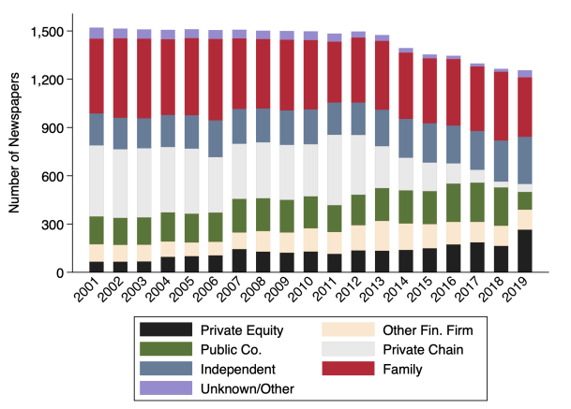
Firm Categorization for Entire Newspaper Industry 2001-2019
WSU

Slide 18
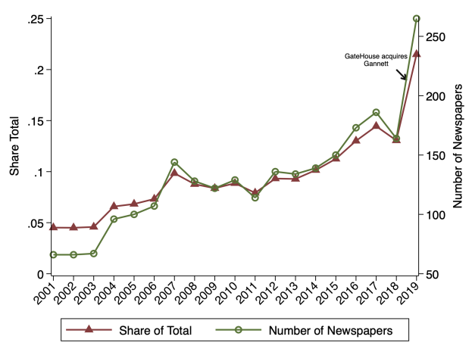
PE Has Seen Growing Ownership in Context of Declining Industry
WSU

Slide 19
Empirical Strategy
WSU
Difference-in-Difference Estimation of Private Equity Ownership Changes

Slide 20
Diff-in-Diff Specification
WSU
$$y_{it}=α_{t}+α_{i}+ β{PE}_{it}+ε_{it}$$
$$y_{it}=\sum_{s=−19}^{19}{β_{s}1}\left[\left(t−T_{i}\right)=s\right]+α_{t},{ α}_{i}+ε_{it}$$
$y_{it}$ = Circulation, local news content, employment, survival in year $t$ for newspaper $i$
$α_{t}$ = year fixed effect
$α_{i}$ = newspaper fixed effect
$T_{i}$ = deal year, after which ${PE}_{it}$ = 1
$β_{s}$ = Impact of year relative to deal on outcome
Timing of deal assumed conditionally exogenous:
$E(ε_{it}$| $x_{it},$ $α_{t}{,α}_{i})=0$

Slide 21
Results
WSU
Document Impacts of Digital Investment on Cost-Cutting

Slide 22
Changing Mediums
WSU
Local newspaper reporting often spills over beyond the paper’s readership, because local TV and especially social media rely on it as a source of information about local government issues.*
*Such information spillovers have implications for revenue – platforms are able to mediate the relationship between news consumer and news producer, forcing outlets to use platform-based services to reach their audience and collecting profits from advertisers (Ardia et al., 2020)
Internet sources, especially social media, do not appear to offer a serious substitute for newspapers’ traditional local issue coverage. Instead, emerging literature on the role of the internet and social media in politics suggests that these sources rely on newspapers for source material while also contributing to the nationalization and segregation of news consumption.

Slide 23
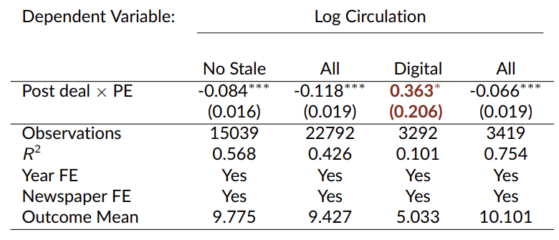
Buyouts Increase Digital
WSU
Buyouts increase digital subscriptions by 43% = (exp(0.36)-1)*100

Slide 24
Survival Rates Also Increase
WSU
Buyouts Lower Failure Rate by 33% = $\frac{0.004}{0.012}$

Slide 25
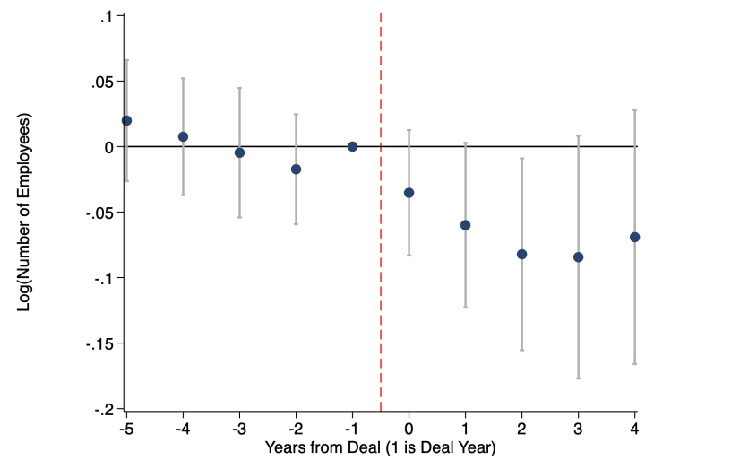
PE Buyouts → Declining Employment
WSU
8% decline in employees by year 3 after buyout

Slide 26
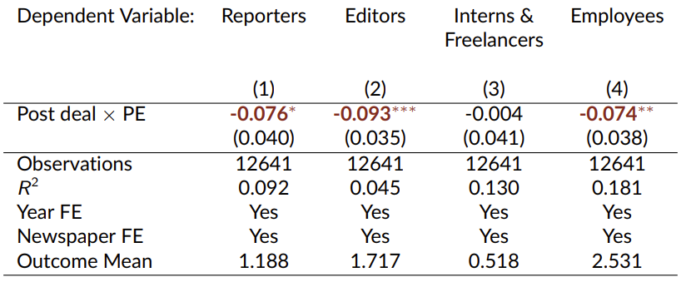
LinkedIn Employment Decline
WSU
7% in total employees; less effect on casual workforce.

Slide 27
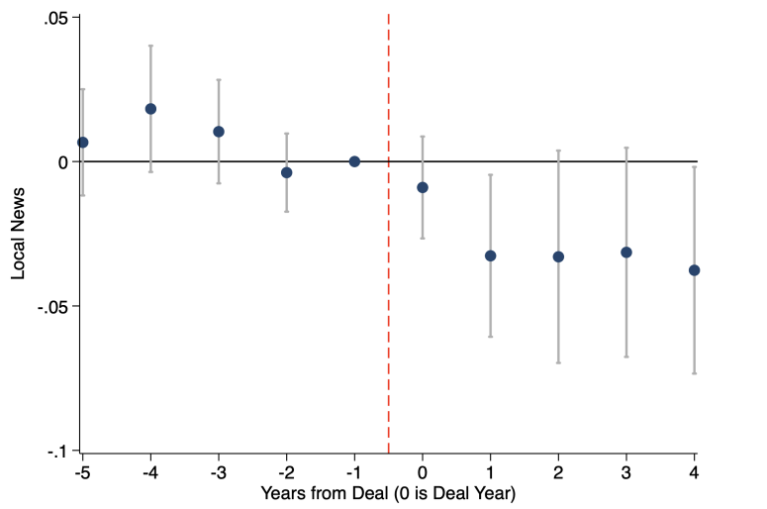
Local News Declines
WSU
Local news: 1) Local Government, 2) Schools, 3) Obituaries

Slide 28
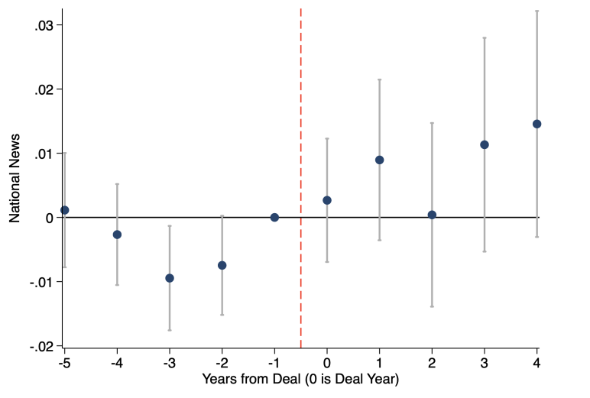
National News Increases
WSU
National news: Bush, Congress, Obama, Trump, White House, Democrat, Republican

Slide 29
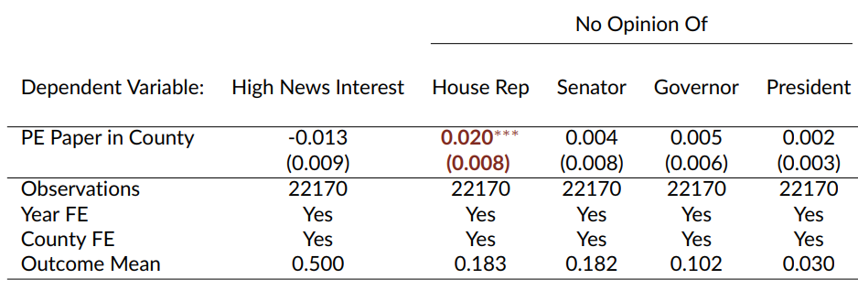
Local News and Engagement Decline
WSU
10.8% decrease in local government news relative to mean; increase in national news.
11% increase in “No Opinion” of local representatives; no impact on national politicians

Slide 30
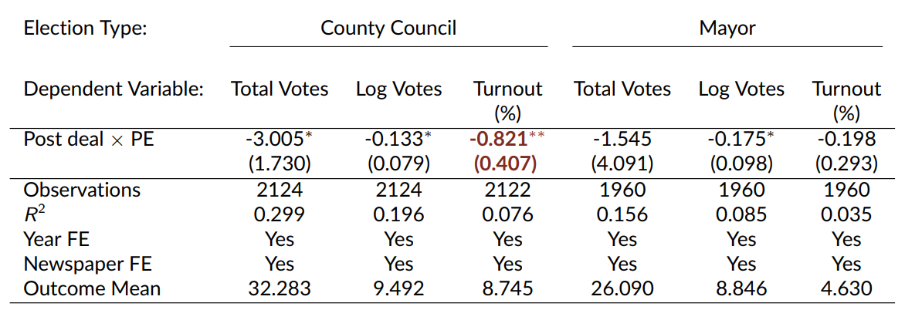
Engagement with Local Politics $↓$
WSU
9.3% decrease in county council turnout.

Slide 31
Conclusions
WSU
“We document nuanced impacts of private equity buyouts on newspapers.”
Positive Impacts:
Digital subscription increases, possibly reflecting greater digital investment
Survival rate increases
Negative Impacts:
Cost-saving and consolidation measures result in layoffs of journalists, particularly those that specialize in local news content
Local news coverage worsens relative to more easily scalable national news
These effects spill over into political knowledge and engagement

