Slide 1
Female Representation in the Academic Finance Profession
JF | 2022

Slide 2
Agenda
WSU
Motivation
Data
Descriptive Statistics
Regression Analysis
Circumstantial Differences
Conclusions

Slide 3
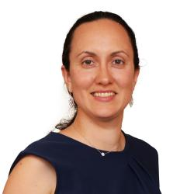
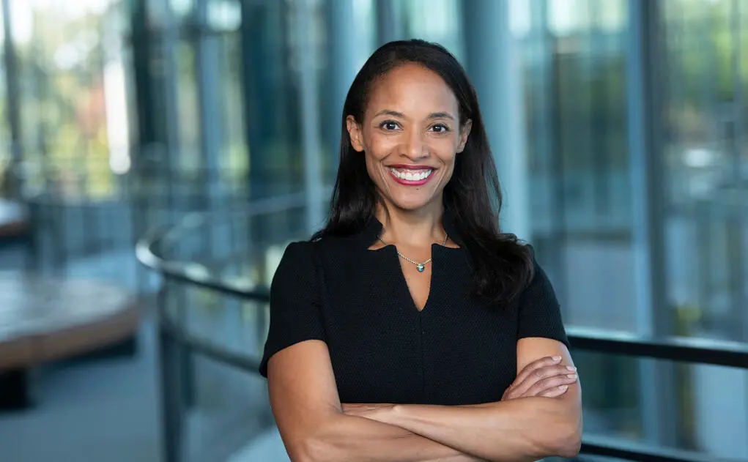
Authors/Literature Review
WSU
Motivation
Mila Sherman (UMass) & Heather Tookes (Yale SOM)
Over the last 4 years, a large body of literature has emerged in economics (e.g., Lundenberg and Stearns (2019), Boustan and Langan (2019), Hengel and Moon (2020), Chari and Goldsmith-Pinkham (2018))
Also, an increase in gender representation research more broadly (e.g., ‘Governance’, Dr. Donna Paul, Ginther et. Al (2016))
Finance academia is a useful setting – in many ways a proxy
In the sample (2009-2017) only 16% are women

Slide 4
3 Main Findings
WSU
Motivation
“Our analysis is primarily descriptive; however, the data point to –”
After controlling for research productivity, women hold positions at lower ranked institutions, are less likely to have tenure than men, and are less likely to be full professors
There is also some evidence that women are paid less than men during the sample period
This gap is largest at high-rank institutions and full professor status
Less-significant gender differences in the case of tenure
Authors find that women publish fewer papers in number, although this gap is mainly due to fewer papers in lower tiered journals
Total publication gap is approximately 17.3% - this is a gap in quantity not quality
Women tend to have fewer coauthors than their male colleagues
These main findings diminish over time – more women are entering the profession and obtaining tenure

Slide 5
Data Sources
WSU
Data
School Ranking
Authors define a top-100 school as any school that appears in the top-100 ranking (US News & World Report) at any point during the 2009 to 2017 sample period.
Business School Faculty Rosters
To construct annual roster of finance faculty, authors merge the U.S. News & World Report’s top-100 list with the faculty roster data obtained from Academic Analytics.
Academic analytics provides information on faculty and research activity of faculty at most departments across the United States – data come from two sources:
Direct submissions from universities
Snapshots of university websites as of November 1st each year
Filtering these results give 97 “top-100” business schools

Slide 6
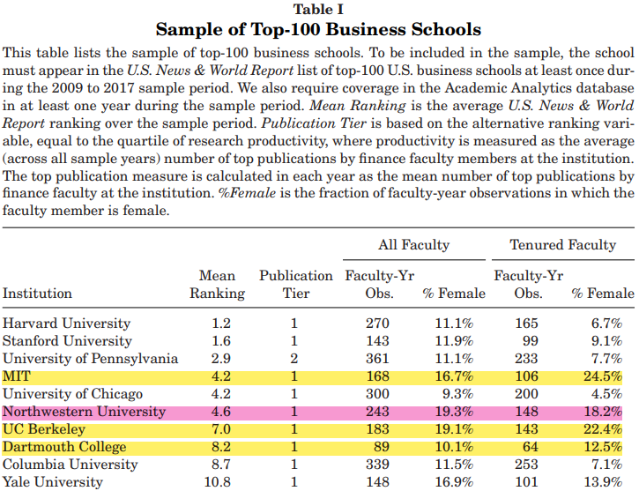
Top-100
WSU
Data
Academic Analytics classifies faculty by subfield, but this can be noisy:
Classification can vary over time
Some finance faculty are listed in some other subfields and some nonfinance faculty are have finance designations
Authors refine their list using publication and CV information (RAs)

Slide 7
Initial Grouping
WSU
Data
Groups 1 & 2
Groups 3 & 4
Group 1:
All faculty who do not have an initial finance assignment but for whom more than 25% of their papers are published in Tier A or Tier B finance journals.
Group 2:
All recent graduates who do not have an initial finance assignment and who have zero publications.
Finance faculty that are not classified as finance.
Group 3:
All faculty initially classified as finance but who do not have at least five Tier A/B publications or at least three publications in Top 3 finance journals.
Group 4:
All faculty with zero publications but an initial finance classification.
Nonfinance faculty that are misclassified as finance.

Slide 8
Demographic Information
WSU
Data
From these restrictions, authors identify 2,011 unique finance faculty members employed by the top-100 schools during the sample period.
Tenure and Full Professor Status
Academic Analytics assigns tenure status for all faculty with an “Associate Professor” or a “Professor” title.
Numerous programs have both tenured and untenured associates
Hand-check CV’s and cross check with Brogaard, Engelberg, and Van Wesep (2018) for top-50 faculty between years of 2009 and 2014
Research Output
Scopus database from Scopus.com for faculty publications and citations data
To limit mismatching, CV’s are hand-checked and Scopus publications are limited to journals in Economics, Econometrics, and Finance; Business Management, and Accounting, and Decision Sciences

Slide 9
Demographic Information
WSU
Data
Gender
Academic Analytics uses genderize.io to infer faculty gender (first and middle names with probability > 90%)
Gender is initially missing from 382 individuals, these were then hand-checked
Transitions
Transitions information comes from CVs > LinkedIn > Way Back Machine (University Webpages)
In the sample, 364 exits (79 of which were to gov’t, private sector, or nonladder positions
Salary (Public Institutions)
Freedom of Information Act (37/60 public institutions)
Submitted request returned 4,123 faculty-year observations (reduced to 3,614 9-month)

Slide 10
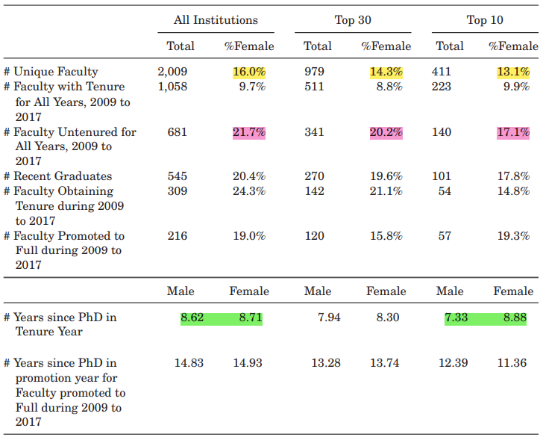
Summary Statistics
WSU
Descriptive Statistics
Between 2009 and 2017, the sample contains 2,009 individual unique faculty members (16% women)
The percentage of female faculty declines at top programs (14.3% and 13.1%, respectively)
Lack of tenure is proportionately higher amongst women
Women also appear to be later in their careers while working in top programs

Slide 11
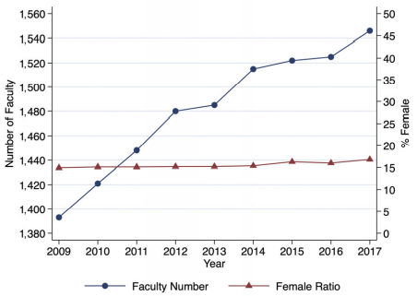
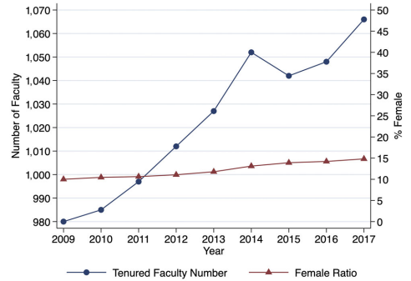
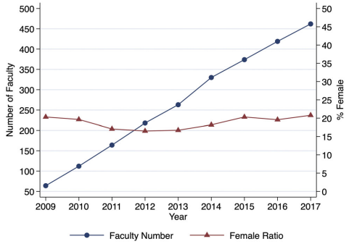
Temporal Changes
WSU
Descriptive Statistics
Figure 1 shows the very slow rate of change in finance faculty composition (14.9% -16.8%). This lags economics and university averages (23.1% and 44.8% in 2017, respectively).
Figure 2 shows that changes in female representation among tenured faculty has been somewhat faster (10%-14.8%).
Figure 3 shows that only a small increase over time in the fraction of female graduates entering the sample each year (20.4%)

Slide 12
Publications
WSU
Descriptive Statistics
The mean number of years since obtaining a PhD is 18.5 for men and 12.1 for women. Still, the patterns can be informative.
Female faculty have approximately 51% the total publications of the average male (particularly true at lower tiered journals)
Considering just the top 3 finance journals and top 5 economics journals, this number jumps to 61%

Slide 13
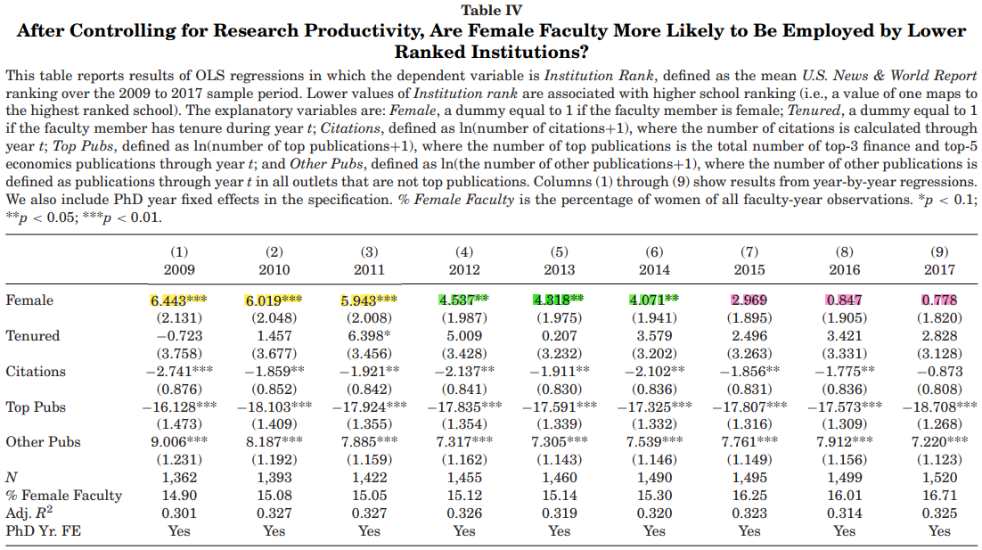
Institution Rank Cross-sectional
WSU
Regression Analysis
Are female faculty more likely to be employed by lower ranked schools?
After controlling for research output, female faculty tend to hold position at lower ranked schools
However, rank can be noisy (variable year-to-year)

Slide 14
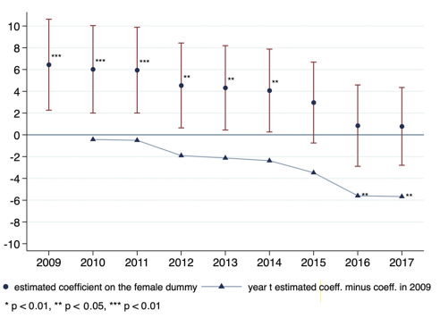
Institution Rank Over Time
WSU
Regression Analysis
Here, Figure 4 shows a steady decline in the estimated gender gap over time
The difference between the estimated coefficients between 2009 and 2017 is significant at the 1% level
Not surprisingly, the authors find that faculty with more citations and top publications are at higher ranked schools (visa versa)

Slide 15
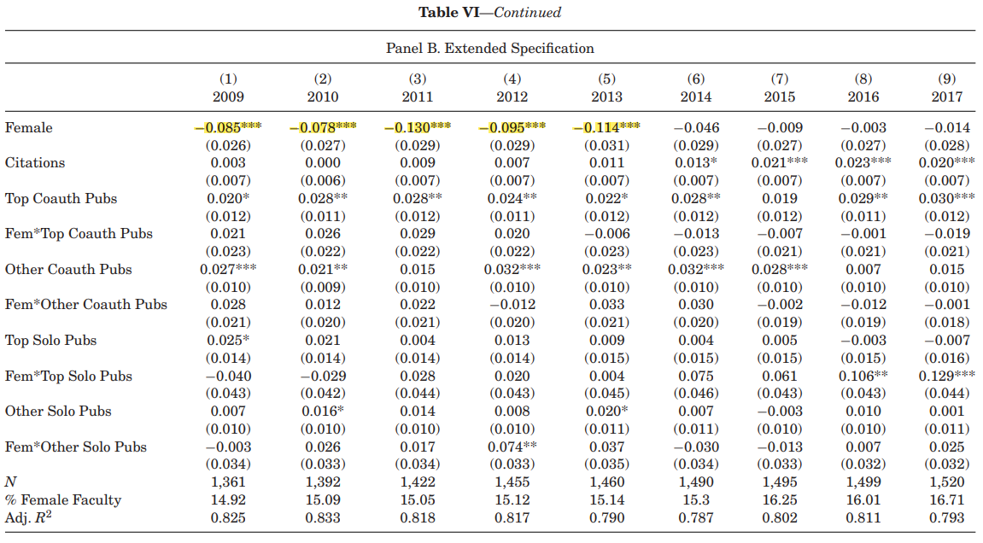
Tenure Status
WSU
Regression Analysis
Following Sarson et al (2021)
Repeated Panel A regressions after dividing publication variables into sol0-authored or coauthored
Interact all publication variables with Female
As in Panel A, there is a negative and significant coefficient on Female (stronger here)
This (4.5% and 8.5%) diminishes over time

Slide 16
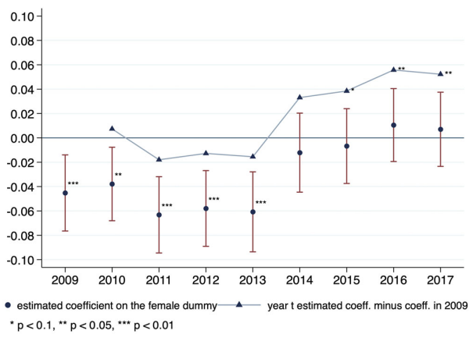
Tenure Over Time
WSU
Regression Analysis
Are female faculty equally likely to have tenure? Year-by-year?
Here, Figure 5 plots estimated coefficients on Female dummy over time
Also plotted are the differences between time t and what is observed in 2009
Between 2009 and 2013, women are between 3.8% and 6.1% less likely to be tenured than men
By 2014, this gap is indistinguishable from zero

Slide 17
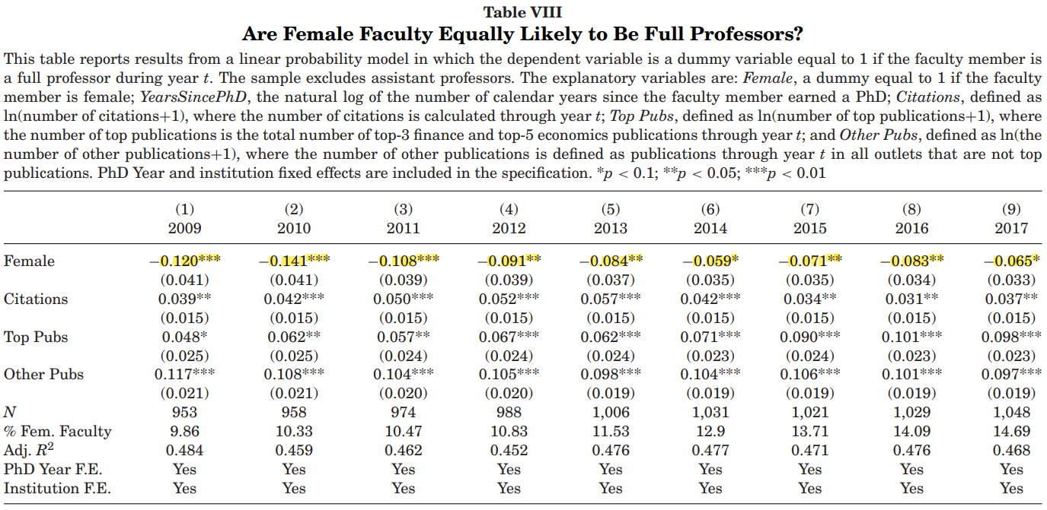
Full Professorship
WSU
Regression Analysis
The authors take an approach similar to that of equality with respect to tenure.
Excluding assistant professors, the authors estimate a linear probability model in which the dependent variable is “full professor” in year t
There appear to be significant gender gaps in each year of the sample

Slide 18
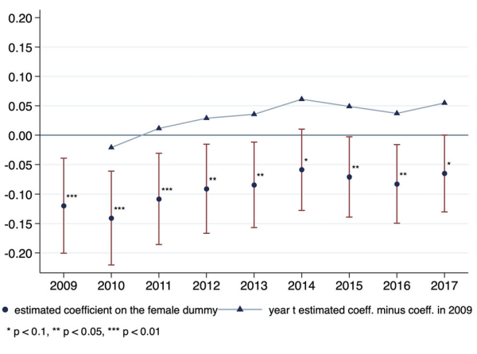
Full Professor Over Time
WSU
Regression Analysis
Are female faculty equally likely to be full professors? Year-by-year?
While the estimated magnitude of the gap appears to be declining, the decrease is not significant
The gender gap at the “top of the ladder” within the academic finance profession remains

Slide 19
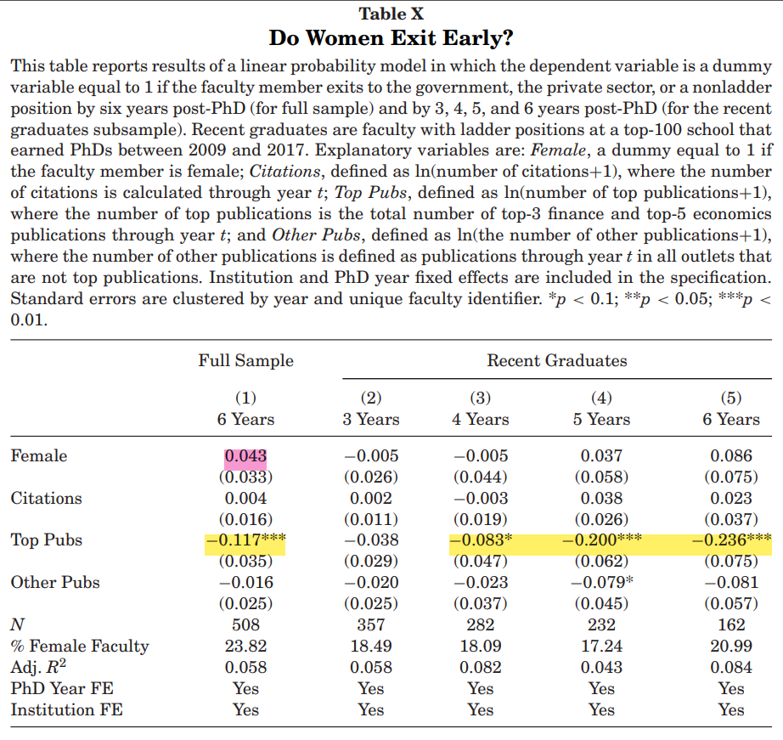
Leaving Early?
WSU
Regression Analysis
The most important determinant of exit is low publication output in top journals.
Column (1) reports results on exits by sample faculty as of 6 years post-PhD
Columns (2) through (5) focus on the subsample of recent graduates and show exits by 3, 4, 5, and 6 years post-PhD
Authors do not observe significant differences between men and women at any horizon

Slide 20
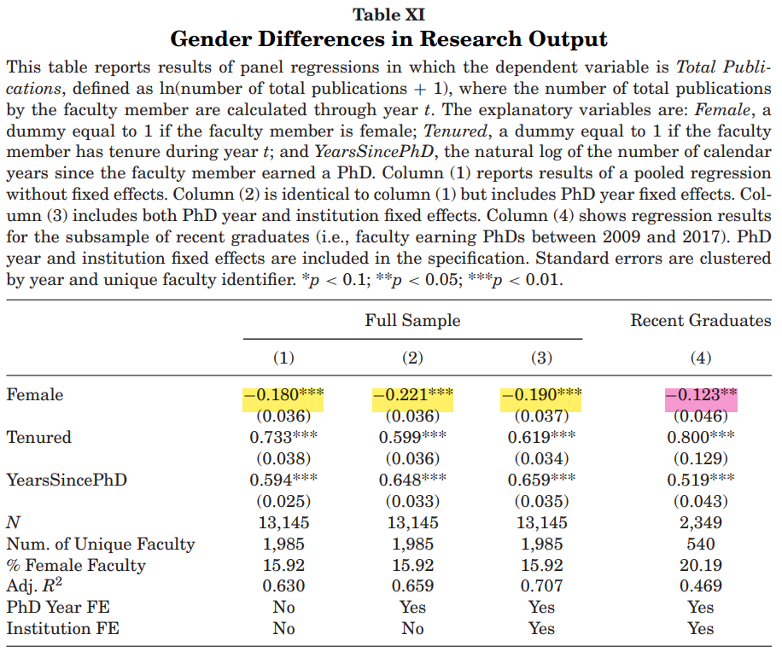
Research Output
WSU
Regression Analysis
Here, Table XI gives results from panel regressions with the dependent variable Total Publications (ln[# of total publications +1])
Column (1) does not include fixed effects
PhD year fixed effects are added in column (2) with institution fixed effects also added in column (3)
Even after control, women tend to publish less than men
-0.190 coefficient on Female in column (3) implies women produce roughly 17.3% fewer published papers than their male colleagues

Slide 21
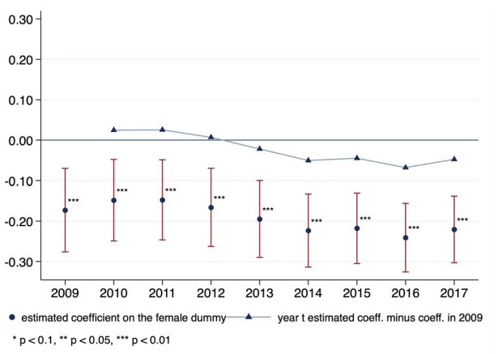
Research Output Over Time
WSU
Regression Analysis
Are there gender differences in research output? Year-by-year?
Unlike previous results, Figure 7 (right) shows no evidence that this publication gap is decreasing over time
This result follows some recent economics literature (research output has lagged in equal dispersion)

Slide 22
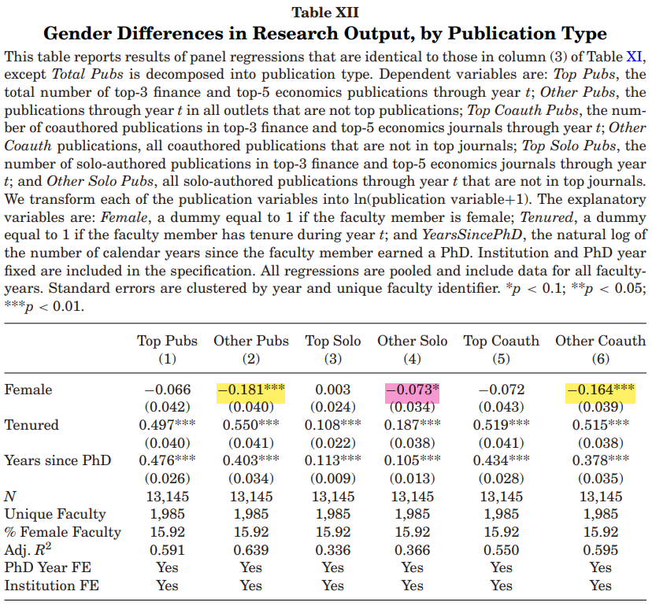
By Publication Type
WSU
Regression Analysis
To better understand these differences:
“Top publications” vs “other publications”
“Top solo publications,” “top coauthored publications,” “other solo publications,” and “other coauthored publications
The gap appears to be driven primarily by coauthored publications in lower tiered journals
There are not statistically significant differences in either solo-authored or coauthored publications at top journals in this sample

Slide 23
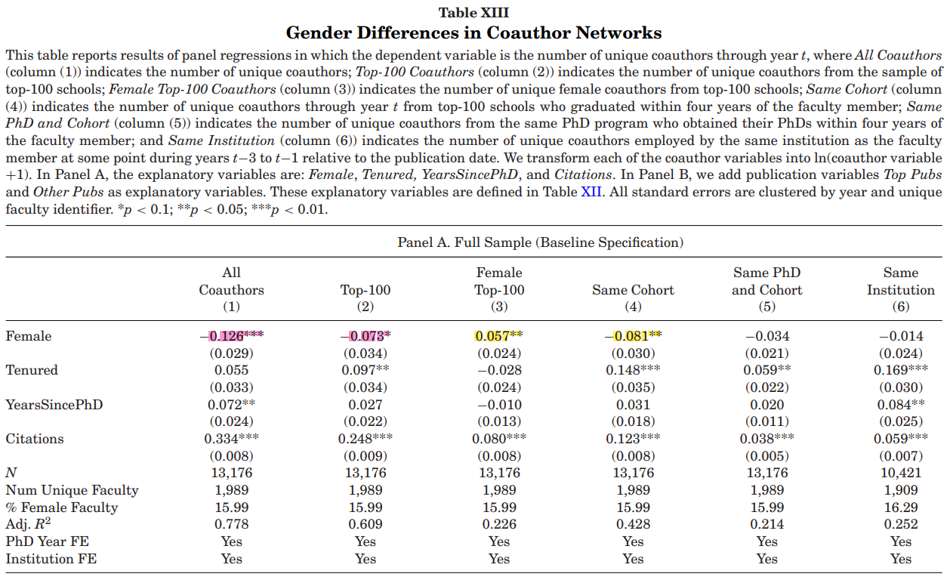
Coauthors
WSU
Regression Analysis
Considering 6 coauthor variables:
All unique coauthors
Coauthors from top-100 schools
Female coauthors from top-100
Top-100 coauthors that obtained PhD w/in 4 years of faculty member
The same PhD program and obtained PhD w/in 4 years
Employed at same institution as faculty during years t-1 to t-3
Women have approximately 11.8% fewer coauthors than men (7.5% top-100)

Slide 24
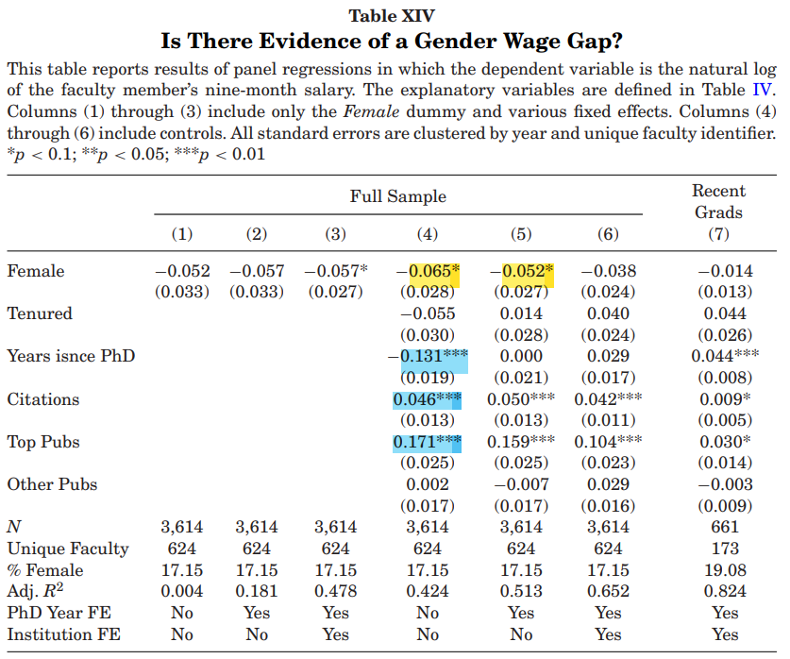
Salary Data
WSU
Regression Analysis
Salary data come from 37/60 public institutions + individual requests from institutions
Authors prefer specifications in column (6) because it controls for faculty productivity and seniority
It appears that gender is a statistically insignificant indicator
What is most informative of salary variation seems to be the number of top publications and citations

Slide 25
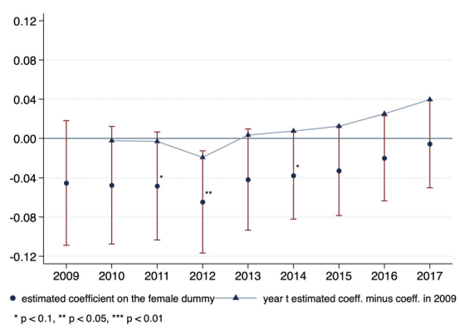
Salary Expectations
WSU
Regression Analysis
Are there gender differences in salary expectations? Year-by-year?
Figure 8 (right) shows that this pay gap is significant during earlier sample years (<2015)
Any salary gap is surprising, given its public scrutiny
The largest estimated wage gaps are in 2011 and 2012 (following the financial crises)
Authors hypothesized that post financial crisis wage adjustments were fast for men than for women

Slide 26
Conclusions
WSU
“We present comprehensive data on female representation in the academic finance profession over the 2009 to 2017 period.”
After controls, women have positions at lower ranked institutions and are less likely to be full professors
This sample is true for “the pay gap”
There are significant differences in research production between men and women
Gender gaps in placement, publications, and salary have been documented in the social sciences, this paper provides further evidence that these results appear to be systematic across disciplines.
Despite this evidence, the status of women in the profession appears to be improving.

